Slide 1


Slide 2

#LifeKoKaroLift
SGC Coaching:
Articulate your Journey | Activate Your Vigour| Accelerate Mutual Growth
Session 13
Principal Component Analysis

Slide 3
Agenda
Quick Recap – (15 min)
Focused Teaching (60 min)
Doubts Resolutions (15 min)
Dimension Reduction
doubts resolutions
PCA
Last 2 weeks

Slide 4
Recap: What the learner have learnt in the week
Quick Glance at Key Learnings
Unsupervised Learning
Clustering
Dimension Reduction
Why
PCA
When needed
K-Mean
How
When
How it work

Slide 5




Focused Learning – Problem Statement
You are working in software company and they want you to classify the 500 emojis as per there type. all smile together, all angry together etc. (Note: all emoji’s are 100*100 size). How you will do it?
As per the question, it looks like a classification problem so we apply a classification algorithm to it. But images are in pixel format so 100*100, then each image will have 10,000 pixels. We can't feed this amount of feature in any algorithm.
We need to do something by which we can reduce the 10,000 feature to a few features like 10. with a minimum amount of information loss. So we can apply the classification algorithm to it.
That method of converting High dimension to low dimension called Dimension Reduction
Notes:
Start with theme of how to show accountability and take initiatives and accepting your mistakes to take corrective actions

Slide 6
Focused Learning –Dimension Reduction
Feature Estimation: Finds a set of new features (i.e., through some mapping f()) from the existing features
Feature Selection: Chooses a subset of the original features

Slide 7

Focused Learning – Feature Estimation
Feature Estimation: Linear combinations are particularly attractive because they are simpler to compute and analytically tractable.
Given x ϵ $R^{N}$, find an N x K matrix U such that:
$y=U^{T}X$, x ϵ $R^{K}$, where K<N
This is a projection from the N-dimensional space to a K-dimensional space.
Notes:
Start with theme of how to show accountability and take initiatives and accepting your mistakes to take corrective actions

Slide 8
Focused Learning – Feature Estimation
From a mathematical point of view, finding an optimum mapping y = 𝑓(x) is equivalent to optimizing an objective function.
Different methods use different objective functions, e.g.,
Information Loss: The goal is to represent the data as accurately as possible (i.e., no loss of information) in the lower-dimensional space.
Discriminatory Information: The goal is to enhance the class-discriminatory information in the lower-dimensional space
Commonly used linear feature extraction methods:
Principal Components Analysis (PCA): Seeks a projection that preserves as much information in the data as possible.
Linear Discriminant Analysis (LDA): Seeks a projection that best discriminates the data.
Notes:
Start with theme of how to show accountability and take initiatives and accepting your mistakes to take corrective actions

Slide 9
Focused Learning – PCA
Find The Mean Vector
Mean Adjusted Matrix
Create Covariance matrix
Find Eigen Valve & Eigen vector
Calculate Basis Vector
Recast the Data

Slide 10
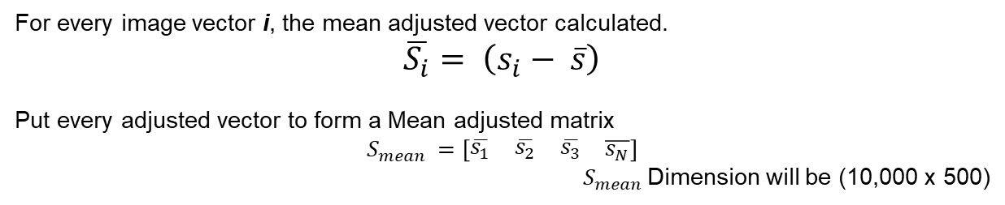
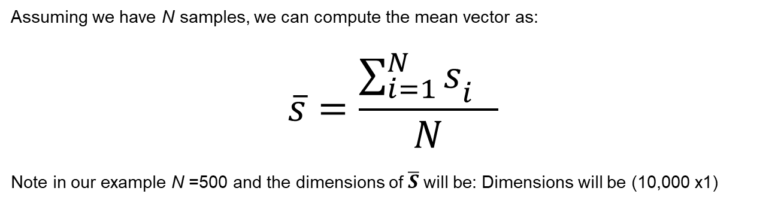
Focused Learning – PCA
1. Calculate the Mean Vector
Assuming we have N samples, we can compute the mean vector as:
$$\overline{s}=\frac{\sum_{i=1}^{N}{s_{i^{}}}}{N}$$
Note in our example N =500 and the dimensions of $\overline{S}$will be: Dimensions will be (10,000 x1)
2. Assemble the mean adjusted matrix
For every image vector i, the mean adjusted vector calculated.
$\overline{S_{i}}= \left(s_{i}− \overline{s}\right)$
Put every adjusted vector to form a Mean adjusted matrix
$$S_{mean }=\left[\begin{matrix}\begin{matrix}\overline{s_{1}} & \overline{s_{2}} & \overline{s_{3}}\end{matrix} & \overline{s_{N}}\end{matrix}\right]$$
$S_{mean }$Dimension will be (10,000 x 500)

Slide 11
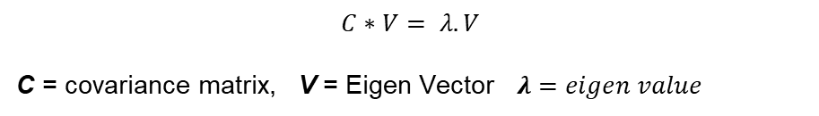
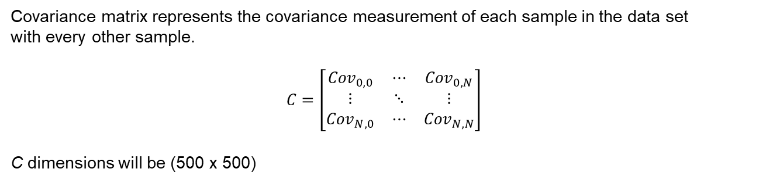
Focused Learning – PCA
3. Computer Covariance matrix
Covariance matrix represents the covariance measurement of each sample in the data set
with every other sample.
$$C=\left[\begin{matrix}{Cov}_{0,0} & ⋯ & {Cov}_{0,N} \\ ⋮ & ⋱ & ⋮ \\ {Cov}_{N, 0} & ⋯ & {Cov}_{N, N}\end{matrix}\right]$$
C dimensions will be (500 x 500)
4. Compute Eigen value and Eigen Vector
$$C∗V= λ.V$$
C = covariance matrix, V = Eigen Vector $λ=eigen value$
$$C ∗V= \left(λ.Ι\right)∗V$$
$$\left(C − λΙ\right)∗V=0$$
$$\det\left(C−λΙ\right)=0$$

Slide 12

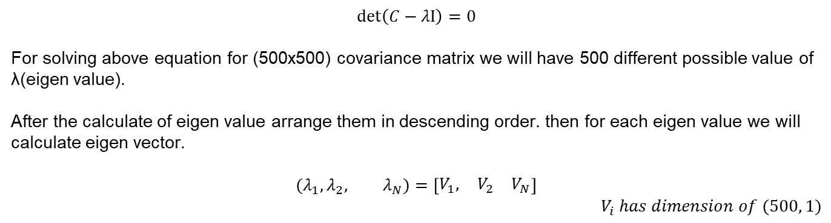
Focused Learning – PCA
4. Compute Eigen value and Eigen Vector
$$\det\left(C−λΙ\right)=0$$
For solving above equation for (500x500) covariance matrix we will have 500 different possible value of λ(eigen value).
After the calculate of eigen value arrange them in descending order. then for each eigen value we will calculate eigen vector.
$$(λ_{1}, λ_{2}, λ_{N})=\left[\begin{matrix}V_{1}, & V_{2} & V_{N}\end{matrix}\right]$$
$$V_{i} has dimension of (500, 1)$$
As already decided how many dimension we are ready to reduce. i.e. the value of k for our example we choose k=10
Now we have eigen vector matrix as
$$EV=\left[\begin{matrix}V_{1} & V_{2} & V_{k}\end{matrix}\right]$$
$$EV dimension will be (500, 10)$$

Slide 13
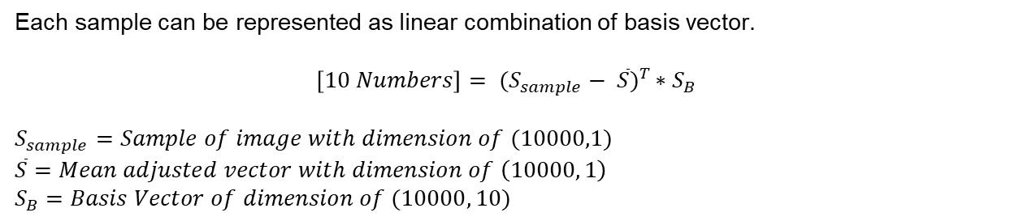
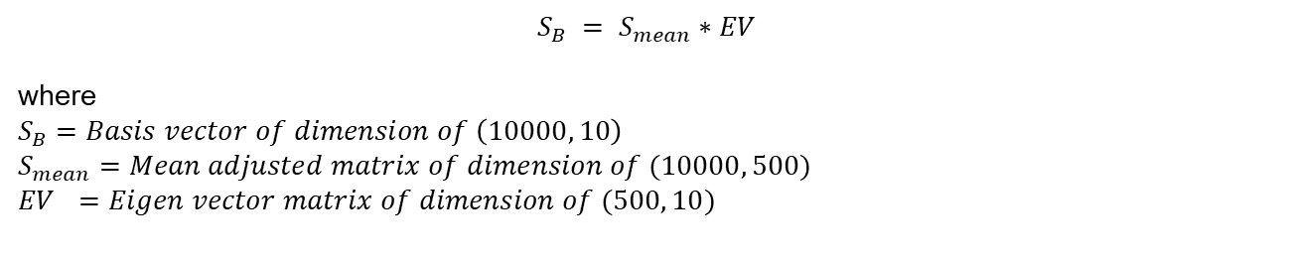
Focused Learning – PCA
5. Compute Basis vector
$$S_{B} = S_{mean}∗EV$$
where
$$S_{B}=Basis vector of dimension of \left(10000, 10\right)$$
$$S_{mean}=Mean adjusted matrix of dimension of (10000, 500)$$
$${EV}_{}=Eigen vector matrix of dimension of (500, 10)$$
6. Represent Each sample
Each sample can be represented as linear combination of basis vector.
$$\left[10 Numbers\right]= {(S_{sample}− \overline{S})}^{T }∗S_{B}$$
$$S_{sample}=Sample of image with dimension of (10000,1)$$
$$\overline{S}=Mean adjusted vector with dimension of \left(10000, 1\right)$$
$$S_{B}=Basis Vector of dimension of (10000, 10)$$
Now we can represent an (10x10) emoji into 10 numbers. We can use as input in classification algo.

Slide 14
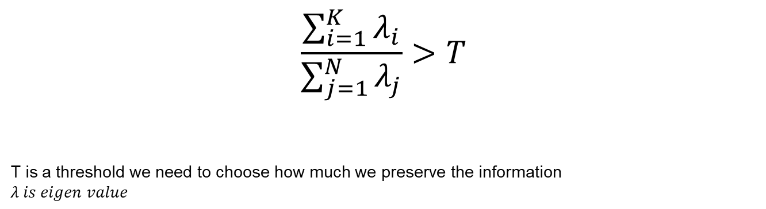
Focused Learning – PCA
How do we choose K?
K is typically chosen based on how much information (variance) we want to preserve:
$$\frac{\sum_{i=1}^{K}{λ_{i}}}{\sum_{j=1}^{N}{λ_{j}}}>T$$
T is a threshold we need to choose how much we preserve the information
$$λ is eigen value$$
If T=0.9, we preserved 90% of information (variance) of Data
If T=1.0, We preserved 100% of information (variance) of Data. i.e (K=N)

Slide 15
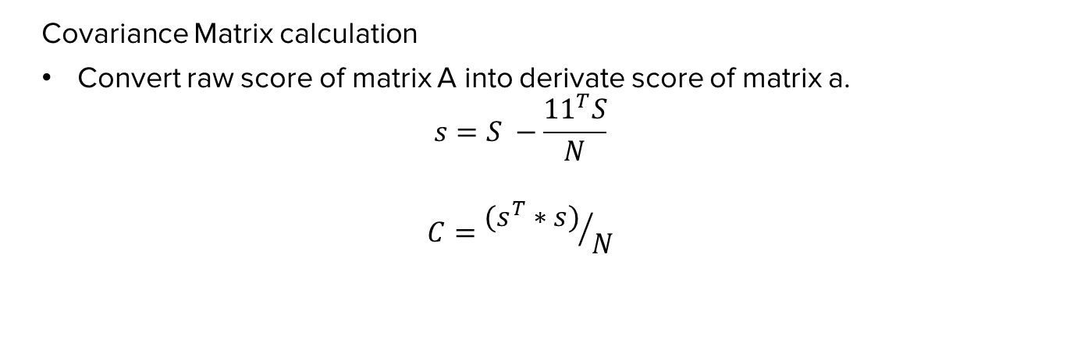
Focused Learning – Covariance matrix
Covariance Matrix calculation
Convert raw score of matrix A into derivate score of matrix a.
$$s=S −\frac{11^{T}S}{N}$$
$$C={(s^{T}∗s)}/N$$

Slide 16
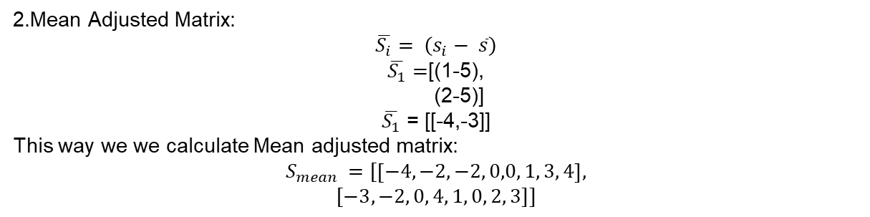
Focus Teaching- Calculating
Let’s compute PCA for Dataset:
(1,2), (3,3), (3,5), (5,4), (5,6), (6,5), (8,7), (9,8)
1.Mean Average:
$\overline{S}$= [5, 5]
2.Mean Adjusted Matrix:
$$\overline{S_{i}}= \left(s_{i}− \overline{s}\right)$$
$\overline{S_{1}}=$[(1-5),
(2-5)]
$\overline{S_{1}}$ = [[-4,-3]]
This way we we calculate Mean adjusted matrix:
$$S_{mean }=[\left[−4,−2,−2, 0,0, 1, 3, 4\right],$$
$$[−3, −2, 0, 4, 1, 0, 2, 3]]$$

Slide 17
Focus Teaching- Calculating
Let’s compute PCA for Dataset:
(1,2), (3,3), (3,5), (5,4), (5,6), (6,5), (8,7), (9,8)
3 Computer Covariance matrix:
4 .Eigen Value

Slide 18
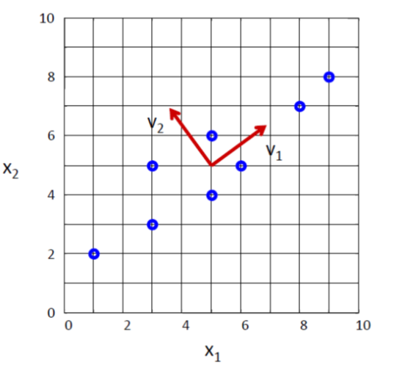
Focus Teaching- Calculating
Let’s compute PCA for Dataset:
(1,2), (3,3), (3,5), (5,4), (5,6), (6,5), (8,7), (9,8)
Eigenvectors are the solutions of the systems:

Slide 19
Focused Learning – PCA
Coding Time
Notes:
Start with theme of how to show accountability and take initiatives and accepting your mistakes to take corrective actions

Slide 20

Doubts Resolutions

